Slide 2
Lesson 3: Object Oriented Design (10hrs)
Writing contracts: Describing and Elaborating Use Cases
Collaboration Diagram and Sequence Diagram
Objects and Patterns (information expert, creator, low coupling, high cohesion, controller)
Determining Visibility
Class Diagram

Slide 3
Determining Visibility
Visibility is the ability of one object to see or have reference to another object.
For a sender object to send a message to a receiver object, the sender must be visible to the receiver.
The sender must have some kind of reference or pointer to the receiver object.

Slide 4
Determining Visibility
When creating a design of interacting objects, it is necessary to ensure that the necessary visibility is present to support message interaction.
In common usage, visibility is the ability of an object to "see" or have a reference to another object.
More generally, it is related to the issue of scope: Is one resource (such as an instance) within the scope of another?

Slide 5
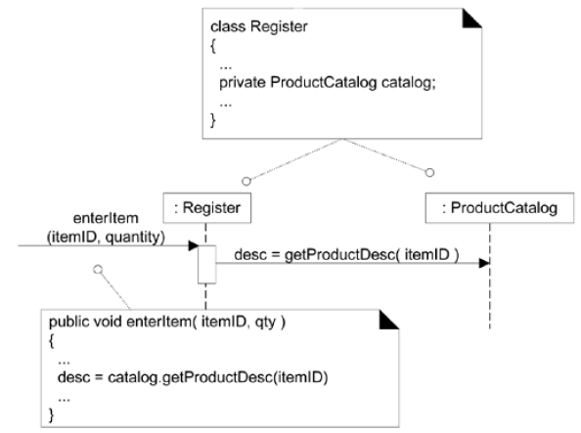
Visibility
The getProductDescription message sent from a Register to a ProductCatalog implies that the ProductCatalog instance is visible to the Register instance
A reference to the ProductCatalog instance is maintained as an attribute of the Register, giving Register visibility to the ProductCatalog.

Slide 6
Determining Visibility
There are four common ways that visibility can be achieved from object A to object B:
Attribute visibility: B is an attribute of A.
Parameter visibility: B is a parameter of a method of A.
Local visibility: B is a (non-parameter) local object in a method of A.
Global visibility: B is in some way globally visible.

Slide 7
Attribute Visibility
Attribute visibility from A to B exists when B is an attribute of A.
It is a relatively permanent visibility because it persists as long as A and B exist.
This is a very common form of visibility in object-oriented systems.

Slide 8
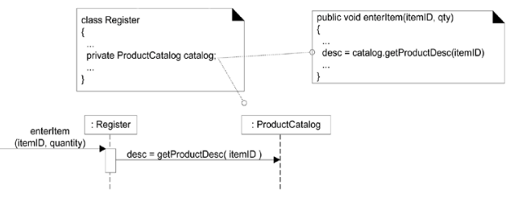
Attribute Visibility
This visibility allows the Register to send the getProductDescription message to a ProductCatalog.

Slide 9
Parameter Visibility
Parameter visibility from A to B exists when B is passed as a parameter to a method of A.
It is a relatively temporary visibility because it persists only within the method’s scope.
After attribute visibility, it is the second most common form of visibility in object-oriented systems.
Parameters are accessible only within the scope of the method.

Slide 10
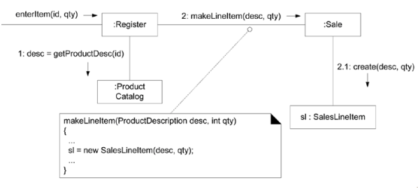
Parameter Visibility
When the makeLineItem message is sent to a Sale instance, a ProductDescription instance is passed as a parameter. Within the scope of the makeLineItem method, the Sale has parameter visibility to a ProductDescription.

Slide 11
Local Visibility
Local visibility from A to B exists when B is declared as a local object within a method of A.
It is a relatively temporary visibility because it persists only within the scope of the method.
Two common means by which local visibility is achieved are:
Create a new local instance and assign it to a local variable.
Assign the returning object from a method invocation to a local variable.

Slide 12
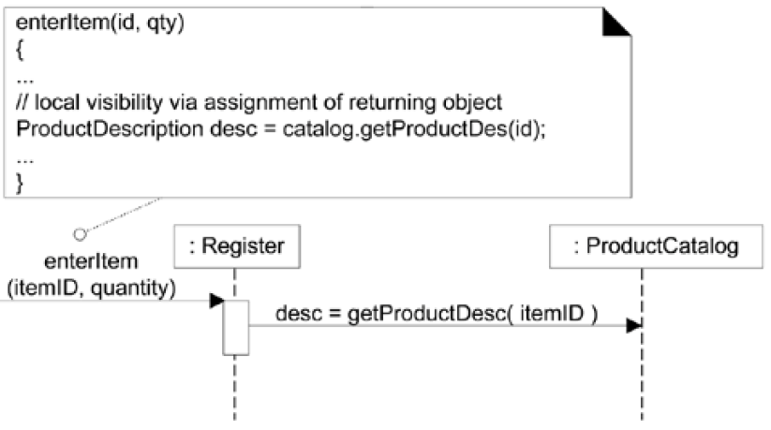
Local Visibility
An example of the second variation (assigning the returning object to a local variable) can be found in the enterItem method of class Register.

Slide 13
Global Visibility
Global visibility from A to B exists when B is global to A.
It is a relatively permanent visibility because it persists as long as A and B exist.
One way to achieve global visibility is to assign an instance to a global variable.
The least common form of visibility in OO Systems.

Slide 14
Visibility
Public
Any outside classifier with visibility to the given classifier can use this feature.
Specified by pre-pending the symbol '+'
Protected
Any descendant of the classifier can use this feature.
Specified by pre-pending the symbol '#'
Private
Only the classifier itself can use the feature.
Specified by pre-pending the symbol '-'

Slide 15
Visibility
Which would you use if you wanted a relatively permanent connection?
Attribute Visibility or Global Visibility
Which would you use if you didn't want a permanent connection?
Parameter Visibility, or Local Visibility
How would you create local visibility?
Create a new instance or use the result of a method call
How would you achieve global visibility?
Use a global variable in C++, static (or class) variable (in C++ or Java) - use the Singleton pattern (a static method that returns the object)

Slide 16
Design Class Diagram - Assignment
Classifier
Keyword
Property Strings
Stereotypes

Slide 18
PREVIEW FOR LECTURE 14
DESIGN CLASS DIAGRAM

